Slide 1

C Practice 1
Notes:
Click to add notes

Slide 2
C Programming Practice Question 1
Write a function called square which take a float argument and return the square result. Print out the result on the serial monitor.
Hint:
1. float square(float x)
Notes:
Lesson descriptions should be brief.

Slide 3
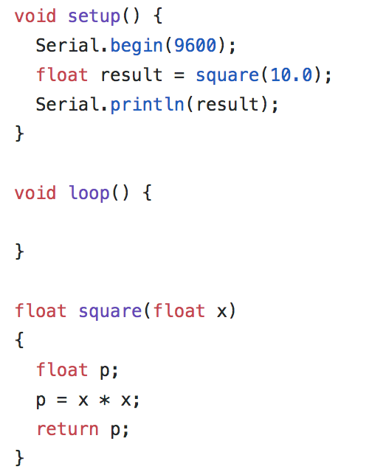
Answer
Notes:
Lesson descriptions should be brief.

Slide 4
Arduino C functions
More Serial port functions
Serial.available() – Get the number of bytes available to read from serial port.
Serial.read() – Read incoming serial data.
Serial.write() – Write data to the serial port.

Slide 5
C Programming Practice Question 2
Print a character received through the serial port.
Hint:
1. Serial.available()
2. Serial.read()
Notes:
Lesson descriptions should be brief.

Slide 6
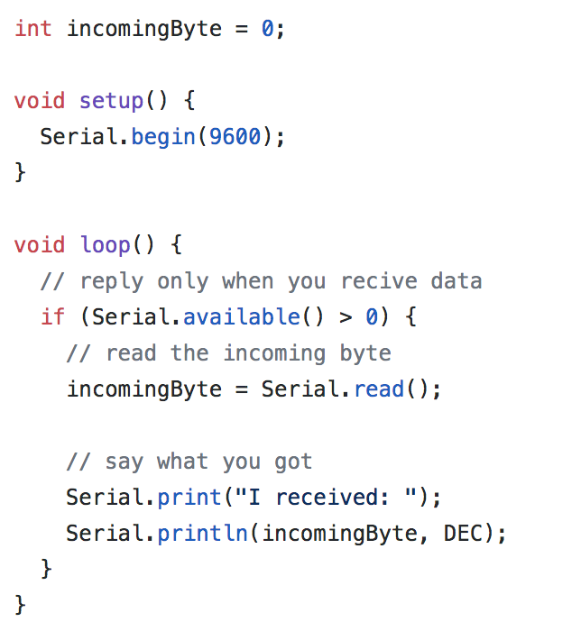
Answer
Notes:
Lesson descriptions should be brief.

